Slide 1



Spring Cloud – Cloud Container and Container Orchestration Audience: Developer

Slide 2
Introduction
Spring Cloud – Cloud Container and Container Orchestration
Who I am: <Instructor Name>
Title
Organization
Role
Background

Slide 3
Agenda
Spring Cloud – Cloud Container and Container Orchestration
Microservices – History, Driving Forces, and Definition
Microservices Patterns
DevOps
Reactive Microservices
1
5
9
13
AD
All
D
AD
A
Microservices Prerequisites
Integration
Securing Microservices
Testing
2
6
10
14
AD
AD
A
D
A
A
Spring Boot
Migrating Monoliths to Microservices
Domain Driven Design Testing
Scaling Microservices
3
7
11
15
AD
D
A
A
A
Case Study
Cloud
UI
Microservices Anti-Patterns
4
8
12
16
AD
AD
All
All
A
A
Legend: All Developer Advanced Developer Architect
All
D
AD
A

Slide 4

Objectives
Spring Cloud – Cloud Container and Container Orchestration
At the end of this training, you should be able to understand the following:
Cloud
Containers
Container Orchestration

Slide 5
Topics
Spring Cloud – Cloud Container and Container Orchestration
Cloud
Containers
Container Orchestration

Slide 6
What are Containers?
Spring Cloud – Cloud Container and Container Orchestration
Containers offer a logical packaging mechanism in which applications can be abstracted from the environment in which they actually run.
Containers are an executable unit of software packaged:
Application code
Along with its libraries and dependencies
Application runtime
Can be run anywhere, whether it be on desktop, traditional IT, or the cloud

Slide 7
Container in Cloud Computing
Spring Cloud – Cloud Container and Container Orchestration
Container in Cloud computing is basically an approach to operating system virtualization.
User can work with a program and its dependencies using resource procedures that are isolated.
The code of the application can be bundled with configurations and dependencies in a systematic manner.
Container in cloud computing is used to build blocks, which help in producing:
operational efficiency
version control
developer productivity
environmental consistency

Slide 8
Difference: VMs versus Containers
Spring Cloud – Cloud Container and Container Orchestration
Virtual Machine (VM) | Containers
A virtual machine (VM) is an emulation of a computer system. A guest operating system (OS) such as Linux or Windows runs on top of a host operating system with virtualized access to the underlying hardware. The operating systems (OS) and their applications share hardware resources from a single host server or from a pool of host servers. Each VM requires its own underlying OS, and the hardware is virtualized. | With containers, instead of virtualizing the underlying computer like a virtual machine (VM), just the OS is virtualized. Containers sit on top of a physical server and its host OS — typically Linux or Windows. Each container shares the host OS kernel and, usually, the binaries and libraries, too. Shared components are read-only. Sharing OS resources, such as, libraries significantly reduces the need to reproduce the operating system code and means that a server can run multiple workloads with a single operating system installation.

Slide 9
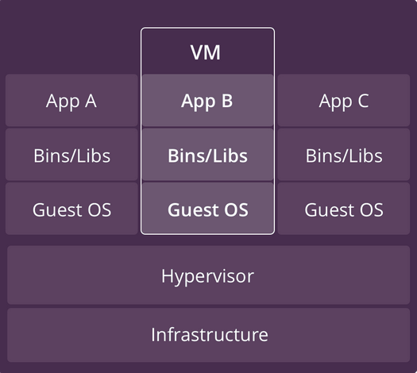
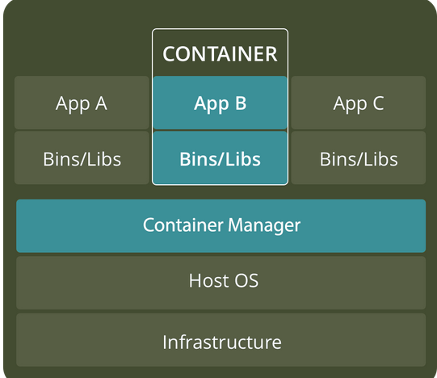
Difference: VMs versus Containers (continued)
Spring Cloud – Cloud Container and Container Orchestration
VMs | Containers
Heavyweight | Lightweight
Limited performance | Native performance
Each VM runs in its own OS | All containers share the host OS
Hardware-level virtualization | OS virtualization
Startup time in minutes | Startup time in milliseconds
Allocates required memory | Requires less memory space
Fully isolated and hence more secure | Process-level isolation, possibly less secure

Slide 10
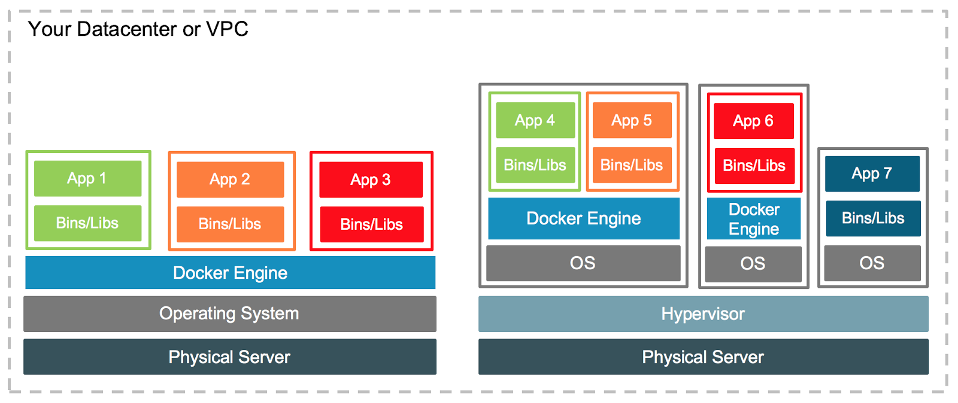
VM and Containers Together
Spring Cloud – Cloud Container and Container Orchestration
https://www.docker.com/blog/containers-and-vms-together/

Slide 11
Popular Container Providers
Spring Cloud – Cloud Container and Container Orchestration
Linux Containers
LXC
LXD
CGManager
Docker
Windows Server Containers

Slide 12
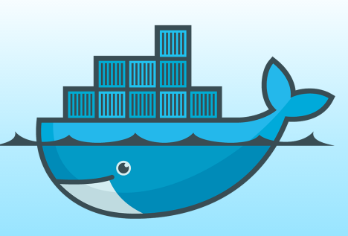
Docker
Spring Cloud – Cloud Container and Container Orchestration
“Docker is a platform for developing, shipping and running applications using container technology.”
Docker is an open-source project that automates the deployment of applications inside software containers, by providing an additional layer of abstraction and automation of operating system–level virtualization on Linux.
[www.docker.com]
[Source: en.wikipedia.org]

Slide 13
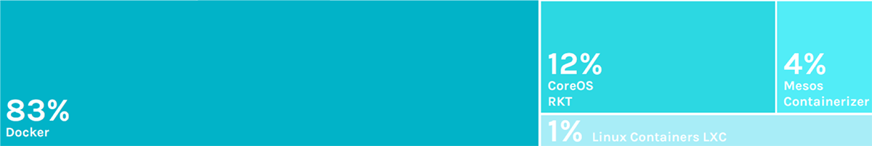
Docker Adoption
Spring Cloud – Cloud Container and Container Orchestration
[www.docker.com]
Figure : Container runtimes: Docker leads, followed by rkt and Mesos.
Image Source :https://sysdig.com/blog/2018-docker-usage-report/

Slide 14
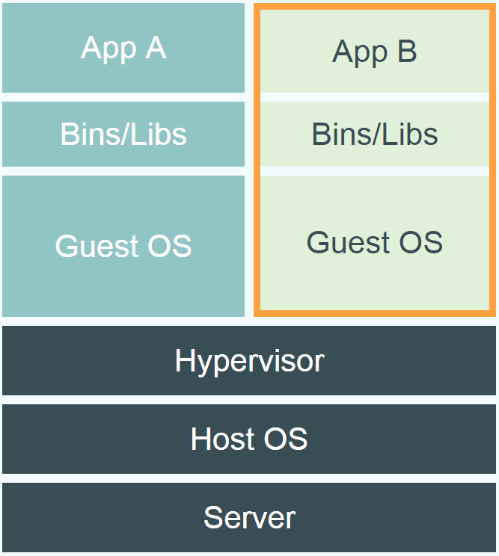
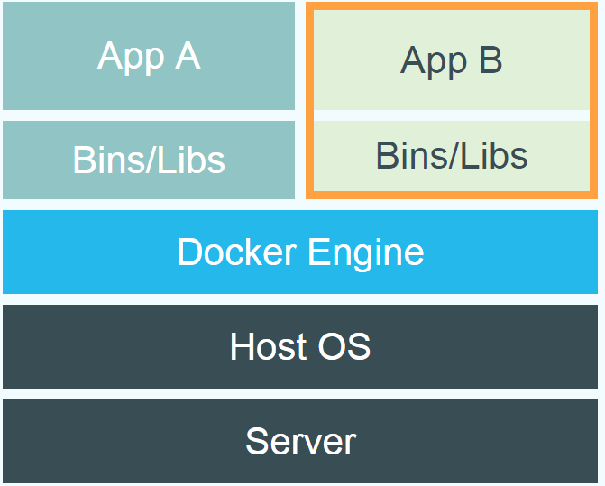
What is Docker: Docker versus VM
Spring Cloud – Cloud Container and Container Orchestration
Provide a uniformed wrapper around a software package: «Build, Ship and Run Any App, Anywhere» [www.docker.com]
Similar to shipping containers: The container is always the same, regardless of the contents and thus fits on all trucks, cranes, ships, ...

Slide 15
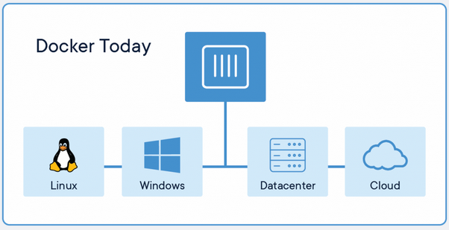
Docker Run Platforms
Spring Cloud – Cloud Container and Container Orchestration
Various Linux distributions (Ubuntu, Fedora, RHEL, Centos, openSUSE, ...)
Cloud (Amazon EC2, Google Compute Engine, Rackspace)
Docker containers and its functionality to Windows Server (sometimes referred to as Docker Windows containers).

Slide 16
Docker Terminology
Spring Cloud – Cloud Container and Container Orchestration
Image: A read-only snapshot of a container that is stored in Docker Hub or in private repository. You use an image as a template for building containers.
Container: The standard unit where the application service is located or transported.
Registry: The registry stores, distributes, and shares container images. It is available in software as a service (SaaS) or in an enterprise to deploy anywhere you that you choose. Docker Hub is a popular registry.
Docker Engine: A program that creates, ships, and runs application containers. The engine runs on any physical or virtual machine or server locally, in private or public cloud. The client communicates with the engine to run commands.
Docker File: An entity that stores a simple, descriptive set of instructions.

Slide 17
Docker Terminology (continued)
Spring Cloud – Cloud Container and Container Orchestration
Image | Container
images: List all local images run: Create a container from an image and execute a command in it tag: Tag an image pull: Download image from repository rmi: Delete a local image | ps: List all running containers ps –a: List all containers (incl. stopped) top: Display processes of a container start: Start a stopped container stop: Stop a running container pause: Pause all processes within a container rm: Delete a container commit: Create an image from a container

Slide 18
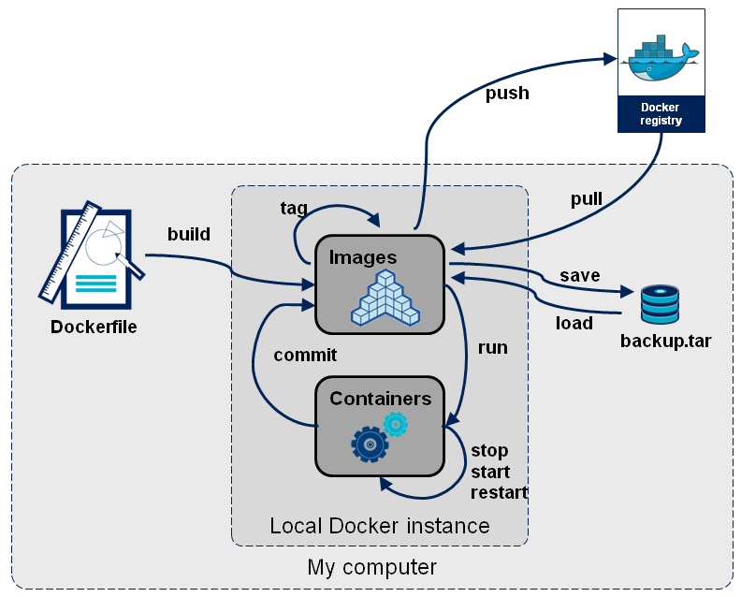
Docker Components
Spring Cloud – Cloud Container and Container Orchestration

Slide 19

Docker Architecture
Spring Cloud – Cloud Container and Container Orchestration
The Docker daemon
The Docker daemon (dockerd) listens for Docker API requests and manages Docker objects such as images, containers, networks, and volumes. A daemon can also communicate with other daemons to manage Docker services.
The Docker client
The Docker client (docker) is the primary way that many Docker users interact with Docker. When you use commands such as docker run, the client sends these commands to dockerd, which carries them out. The docker command uses the Docker API. The Docker client can communicate with more than one daemon.
Docker registries
A Docker registry stores Docker images. Docker Hub is a public registry that anyone can use, and Docker is configured to look for images on Docker Hub by default. You can even run your own private registry
When you use the docker pull or docker run commands, the required images are pulled from your configured registry. When you use the docker push command, your image is pushed to your configured registry.
Docker objects
Images
An image is a read-only template with instructions for creating a Docker container. Often, an image is based on another image, with some additional customization
Containers
A container is a runnable instance of an image. You can create, start, stop, move, or delete a container using the Docker API or CLI. You can connect a container to one or more networks, attach storage to it,or even create a new image based on its current state.
Services
Services allow you to scale containers across multiple Docker daemons, which all work together as a multiple managers and workers. Each member of a swarm is a Docker daemon, and the daemons all communicate using the Docker API. A service allows you to define the desired state,
such as the number of replicas of the service that must be available at any given time.

Slide 20
Lab
Working with docker-machine to create a new docker host.
User docker CLI to work with images and docker containers.
Create and deploy lab microservices as docker containers.
Notes:
Here you can just run the project. Emphasize that it is just a Java “main” application.
It will simply load the Spring application context, then exit when it is apparent there is nothing else to do.
We will add to this later.

Slide 21

Q&A

Slide 22

Summary
Spring Cloud – Cloud Container and Container Orchestration
Summary
In this course, you learned about the following:
Cloud
Cloud Models
Hypervisor
Containers

